Slide 1
Welcome to my presentation

Slide 2

Topic:Shuvo business center
Name: IZAZUL RAHMAN SHUVO
Batch: 20
Date: 5-10-2024

Slide 3
INTRODUCTION
Over view of shuvo business centre
To enhance the digital experience by providing innovative, high-quality electronic accessories that empower users in their daily lives.
Tech-savvy consumers, students, professionals, and families looking for reliable and stylish accessories to complement their devices.
Focus on eco-friendly materials and packaging, as well as a recycling program for old electronics.
Recognized for exceptional customer service and innovation, with several awards for product design and sustainability

Slide 4
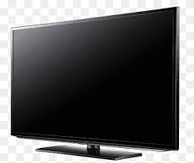
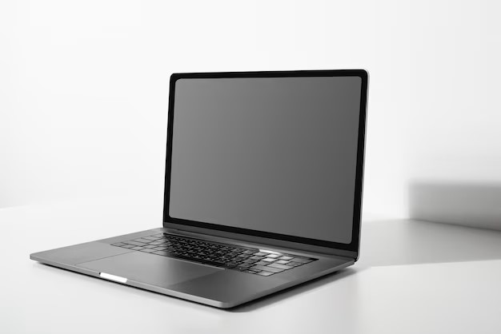
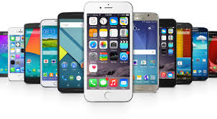
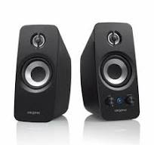
PRODUCTS

Slide 5
Overview of services
Screen replacements, battery issues, software updates.
Quality checked laptops at discounted price
Help with configuring smart TV features and apps.
Troubleshooting, malware removal, system optimization.

Slide 6
BUSINESS PLAN
RECIVE INVENTOY
CHEK ORDERR
FOLLOW UP
SHIP PRODUCT
PROCESS PAYMENT

Slide 7



Slide 8
SALES AND STATICS
PRODUCT | ORDER | INCOME
smart phone | 50 | 435679
laptop | 23 | 520076
speaker | 17 | 234567
tv | 15 | 456789
TOTAL | 105 | 1647111

Slide 9
CONCLUSION
SHUVO BUSINESS CENTRE is dedicated to providing reliable, efficient, and customer-focused delivery services. Our commitment to innovation, sustainability, and exceptional service ensures that we meet the evolving needs of our clients while maintaining the highest standards of quality. As we continue to expand our network and enhance our technology, we remain focused on building lasting relationships with our customers and partners. Together, we are driving the future of delivery, making it faster, safer, and more accessible for everyone.
CONTACT US:-
Shuvo tech bd
Hafizutech bd
Arosh t ech bd

Slide 10


Slide 11
Thank you

